Slide 1

Bank Loan Analysis
By group 2 project P-176 2023

Slide 2
KPI’s & Analysis
Kpi 1 | Kpi 2 | Kpi 3 | Kpi 4 | Kpi 5
Year wise loan amount Stats | Grade and sub grade wise revolving balance | Total Payment for Verified Status Vs Total Payment for Non Verified Status | State wise and last credit pull date wise loan status | Home ownership Vs last payment date stats

Slide 3
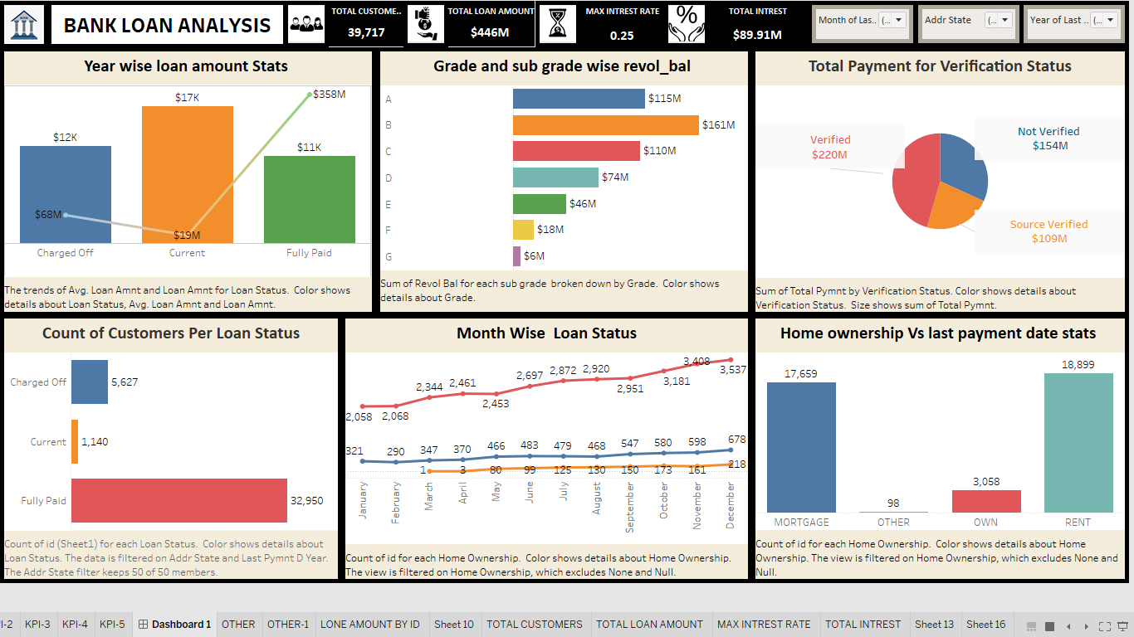
TABLEAU DASHBOARD

Slide 4
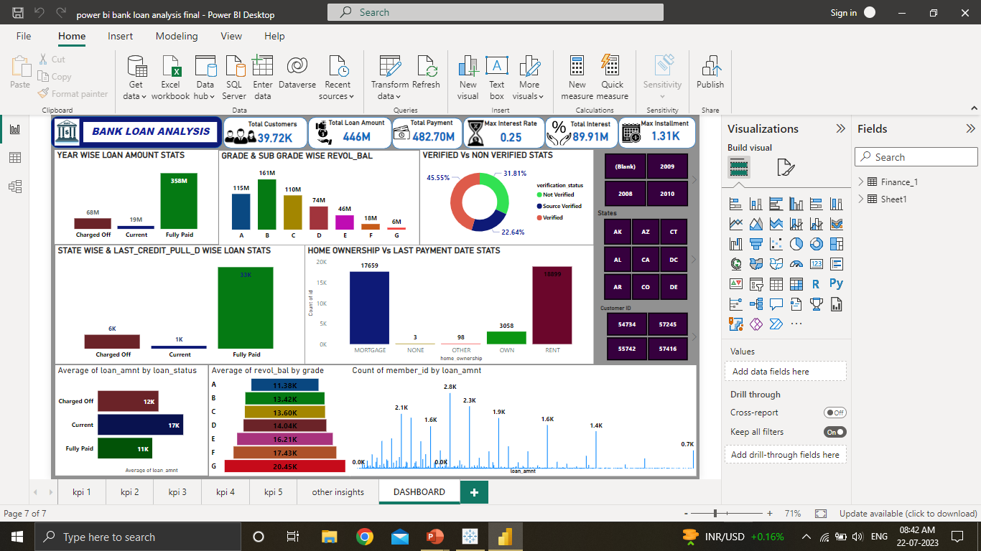
POWER BI DASHBOARD

Slide 5
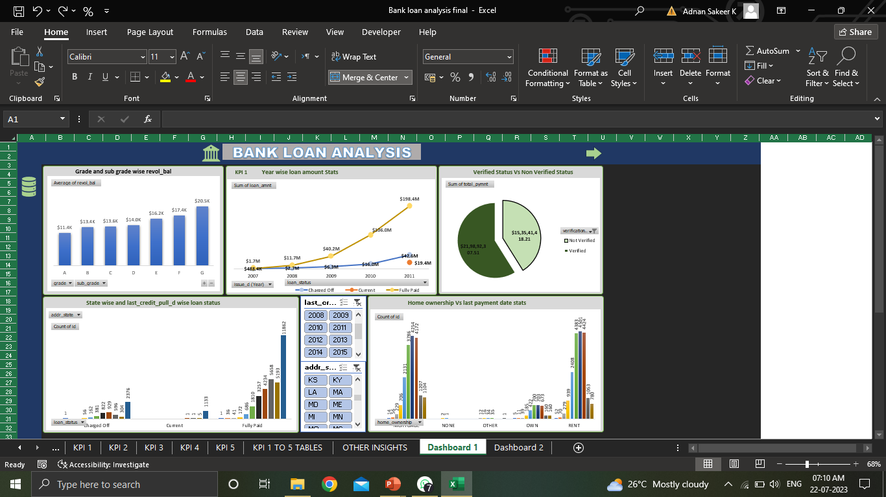
EXCEL DASHBOARD

Slide 6
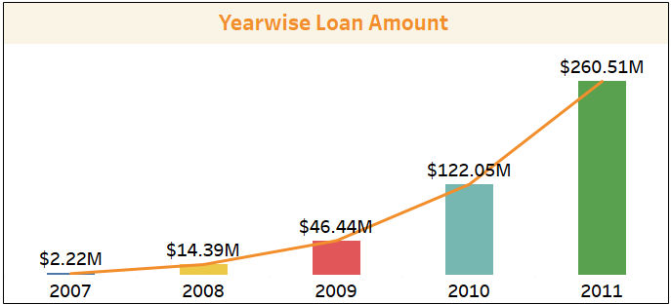
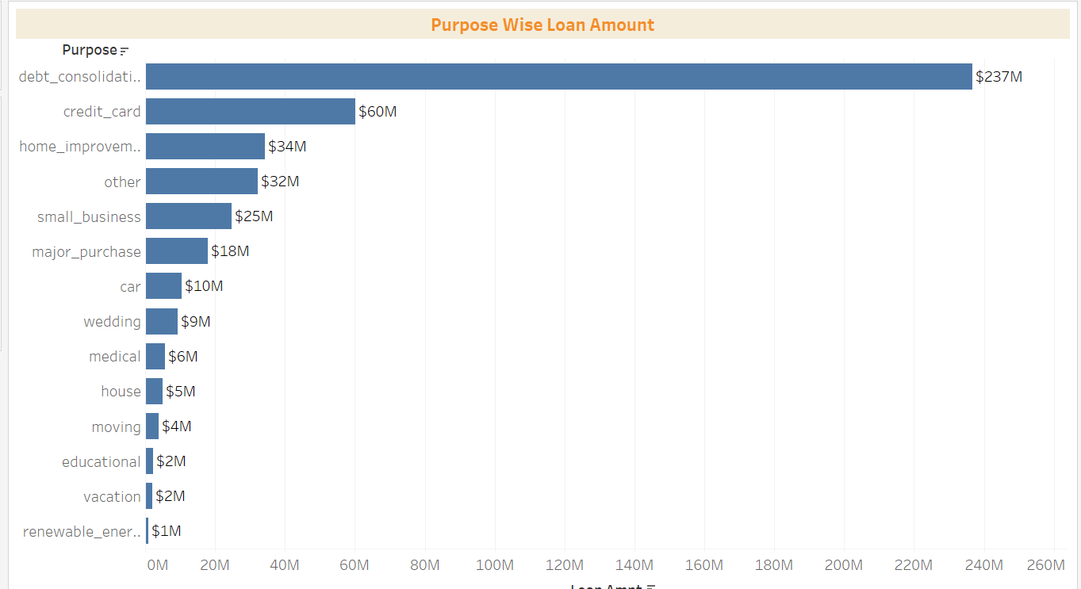
Year Wise Loan Amount
From 2007 to 2011 total $446 million of loan amount and 39,717 total number of loan have is issued.
The year 2011 is the year in which maximum loan amount was issued i.e. $260 million.
Most of the loan issued in December month except for year 2008.In this year maximum amount of loan issued in March month i.e. $2.69 million.
The maximum loan amount issued in California state i.e. $80 million
Loan issued for top 3 purpose are as follows :
a) Debt Consolidation($237 million)
b) Credit Card($60 million)
c) Home Improvement ($60 million)

Slide 7
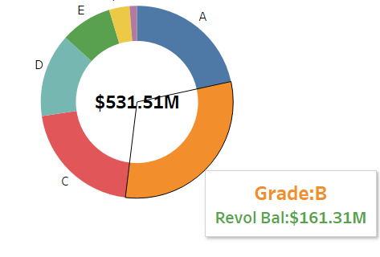
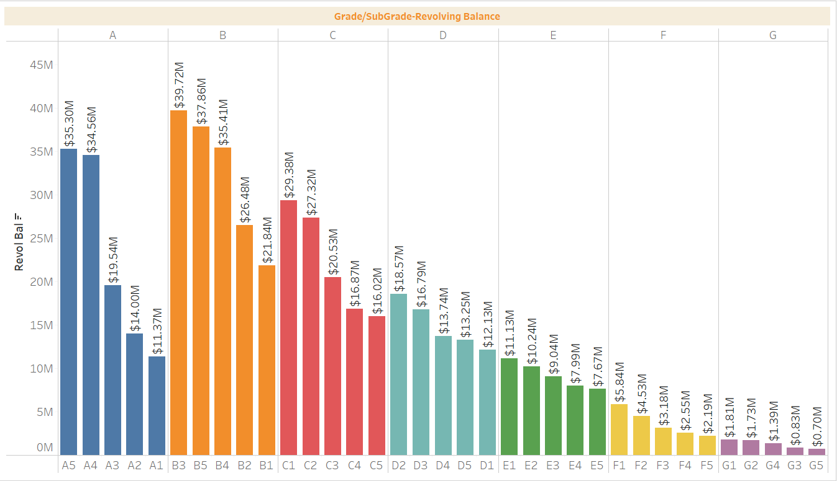
Grade/Sub-Grade Wise Revolving Balance
The balance that carries over from one month to the next is the revolving balance on that loan.
The revolving balance is highest for grade B i.e. $161 million and for sub grade B3 i.e. $39 million.
Also, Annual income for sub grade B3 is highest i.e. $205 million.
In California state revolving balance is maximum i.e. $97 million.
For debt consolidation and for 36 months term we have the highest revolving balance i.e. $180 million.

Slide 8
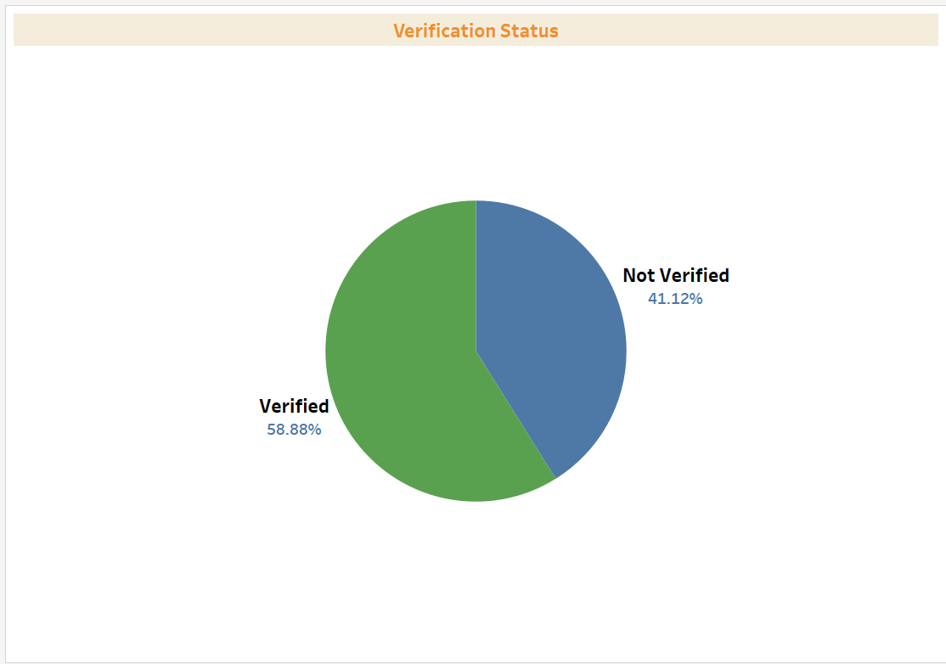
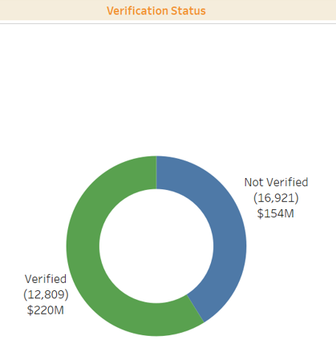
Total Payment for Verified/Not Verified Status
Share of total payment for verified status is 58.88% and for not verified status is 41.12%.
Total payment for verified status is $220 million and for not verified status is $154 million, count of verified status is 12,809 and not verified status is 16,921.
Total principal received for verified status is $172 million and for not verified status is $129 million.
Total interest received for verified status is $46 million and for not verified status is $24 million.
For 36 months term we have total payment amount for verified status is $108 million and for not verified status is $15 million . Whereas, for 60 months term we have total payment amount for verified status is $112 million and for not verified status is $27 million.

Slide 9
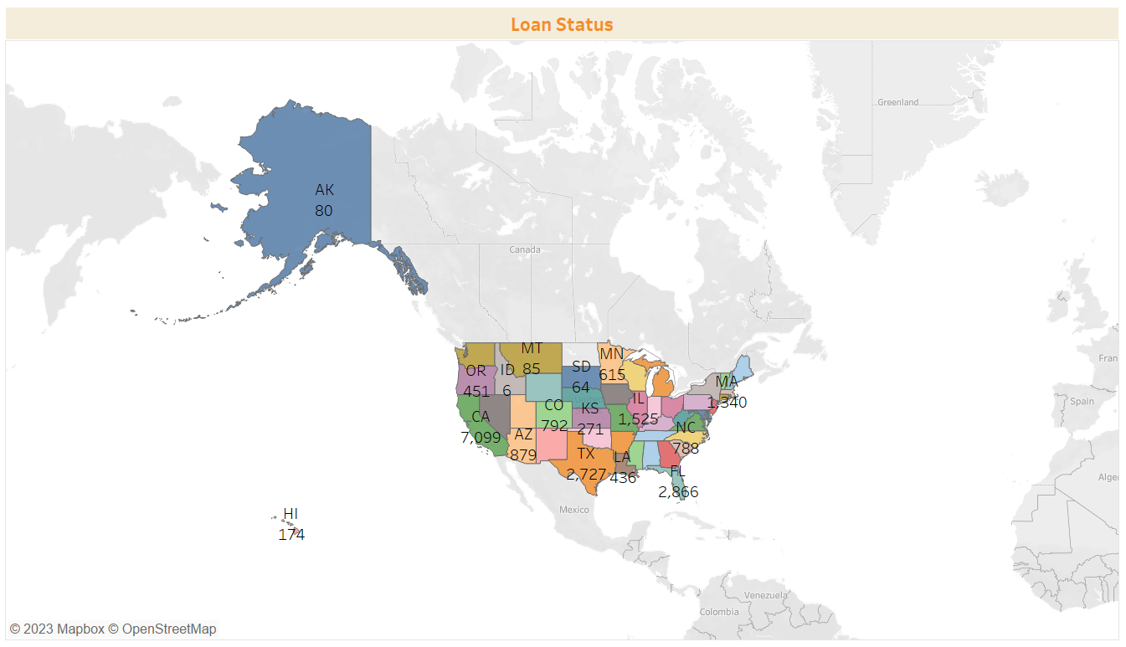
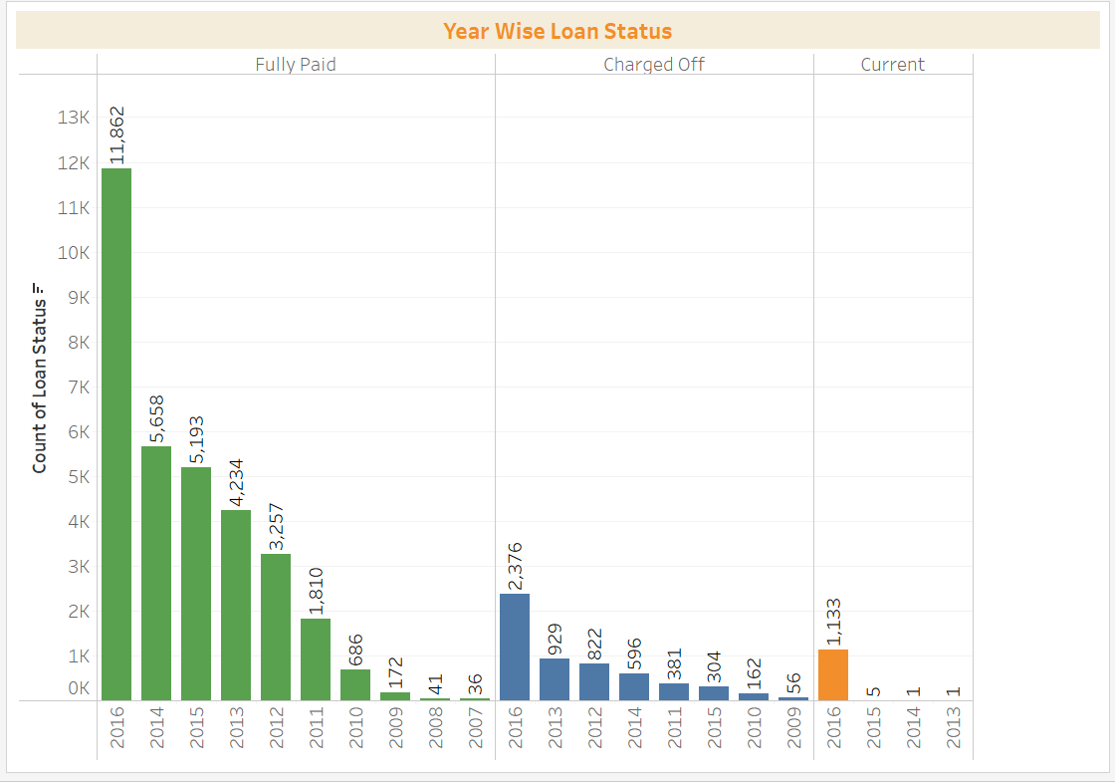
State and Last Credit Pull Date Wise Loan Status
Here, we have three types of loan status fully paid, charged off and current . Fully paid and current loan status comes under good category loan ,whereas, charged off loan status comes under bad category loan status.
In California state we have the highest count of loan status i.e. 7,099.In which we have 5,824 fully paid,1,125 charged off and 150 current.
Also, In year 2016 we have highest count of loan status 11,862 for fully paid , 2,376 for charged off and 1,133 for current loan status.
In California state we have highest last payment amount and received interest i.e. $18 million and $15 million , respectively.
Also, in California we have the highest number of total account 1,45,021 in which the number of open account is 62,679.

Slide 10
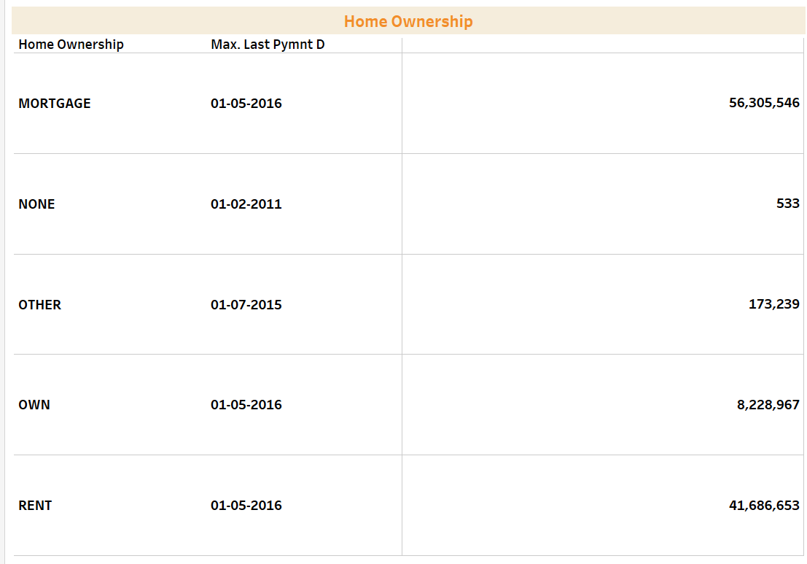
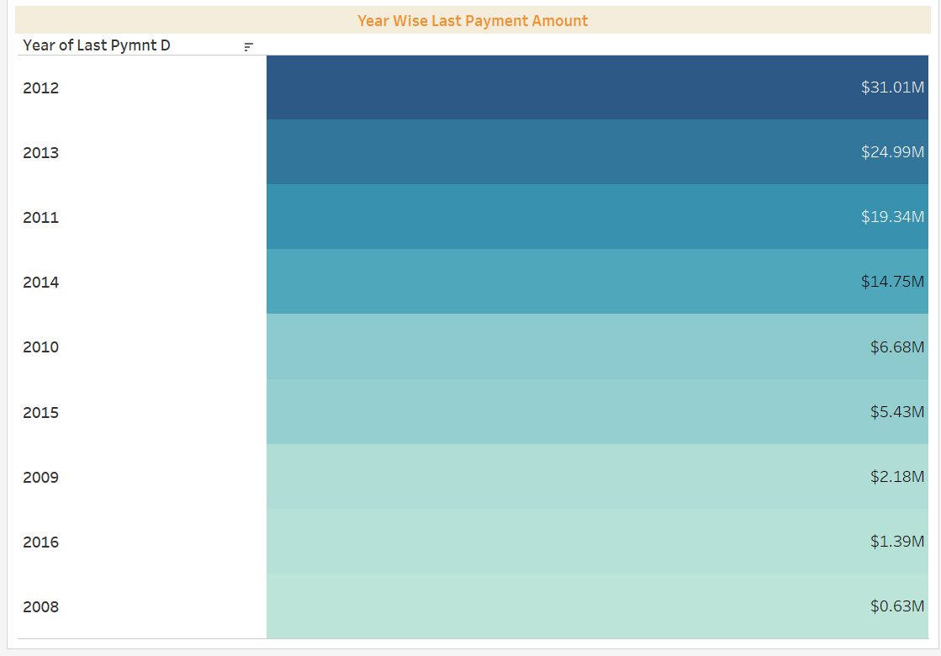
Home Ownership Vs. Last Payment Date
There are five types of home ownership mortgage, rent, own, other and none.
For mortgage we have maximum last payment amount i.e. $56 million on 01-05-2016.
Last payment is highest for year 2012 i.e. $31 million and lowest for year 2008 i.e. $0.63 million.
Year wise count of home ownership is maximum for 2013.

Slide 11
Meet Our Team Members:
1.Srinivas Babu
2.Krishna Reddy
3.Rajalakshmi S T
4.Sreerag A
5. Adnan Sakeer K
6.Farha Sulthana
7.Mahinder Gehlot

Slide 12
Thank You
Mr. Bidhan Sen Sir and Ms. Thanuja Ma’am For your Continuous Support and Assistance throughout the project journey.
As Well as, Last but not the least,
Thanks to the Listeners and Project Mates.

